Slide 1

Real-time Software Engineering
(RTSE)
Week 2
Department of software engineering
Faculty of Computing
UTM

Slide 2

Introduction
Challenges in ERT systems
Software development lifecycle
Software engineering essential for ERT
Conclusion
SCSJ 4423 – Real-time Software Engineering

Slide 3
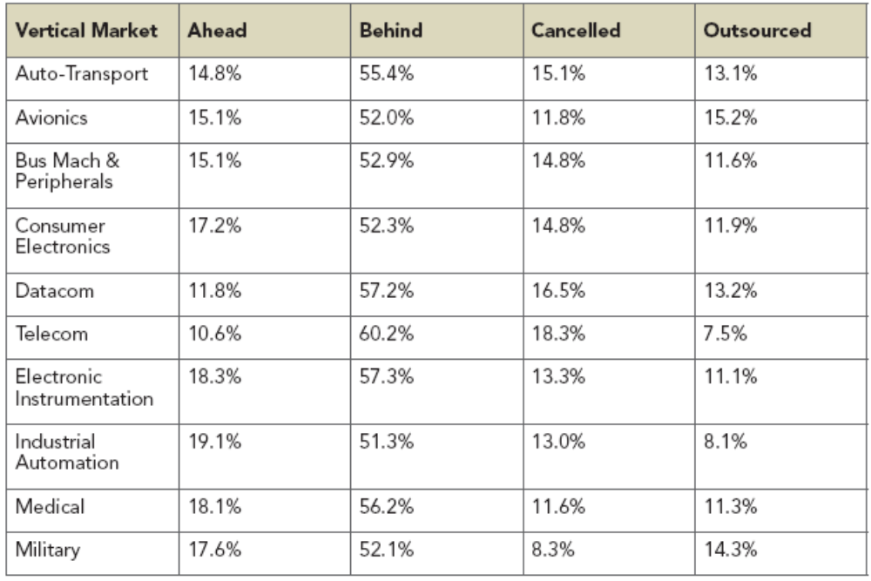
Introduction
Survey (2005) on embedded systems design completions –
in all applications, > 51% are behind schedule!
SCSJ 4423 – Real-time Software Engineering

Slide 4
Introduction
Challenges
Product
Development
Software
Engineer
SCSJ 4423 – Real-time Software Engineering

Slide 5
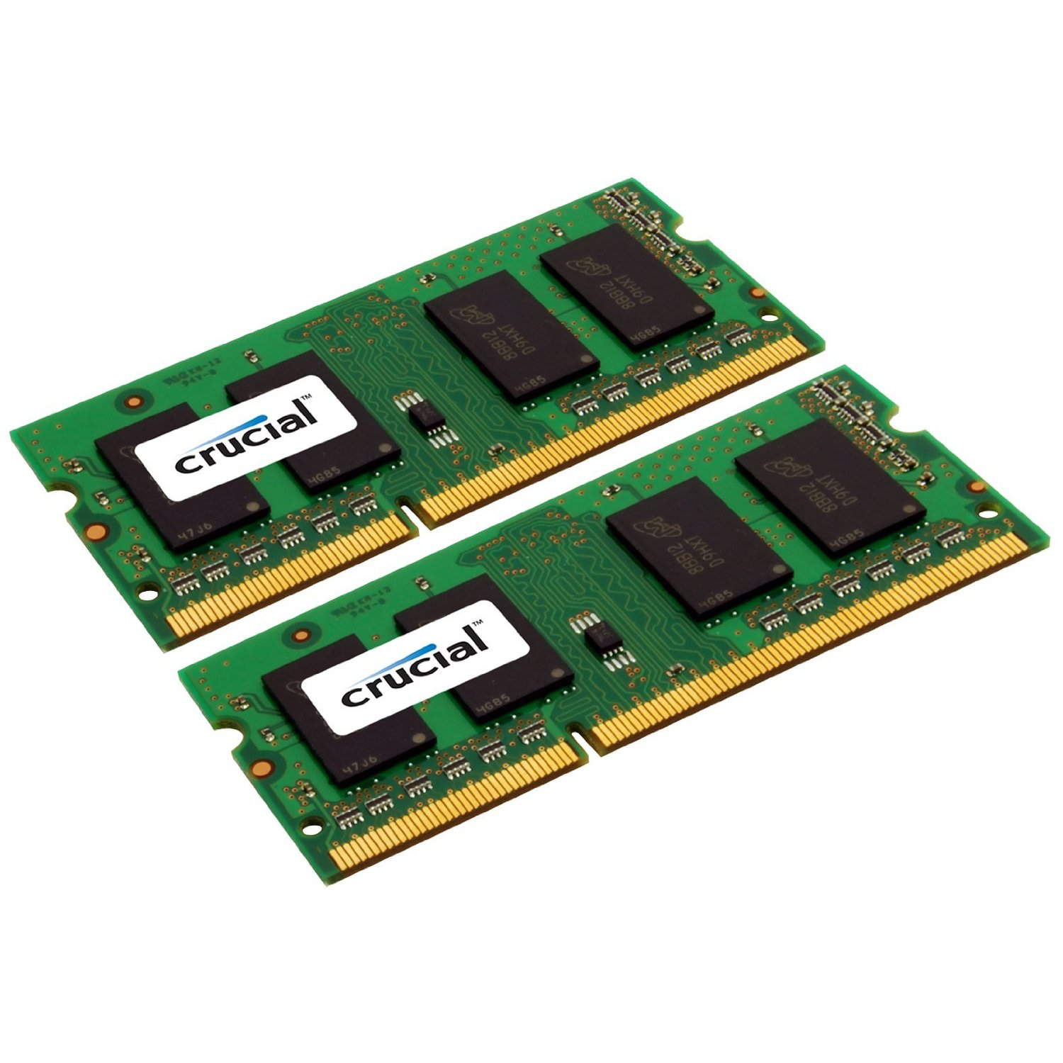
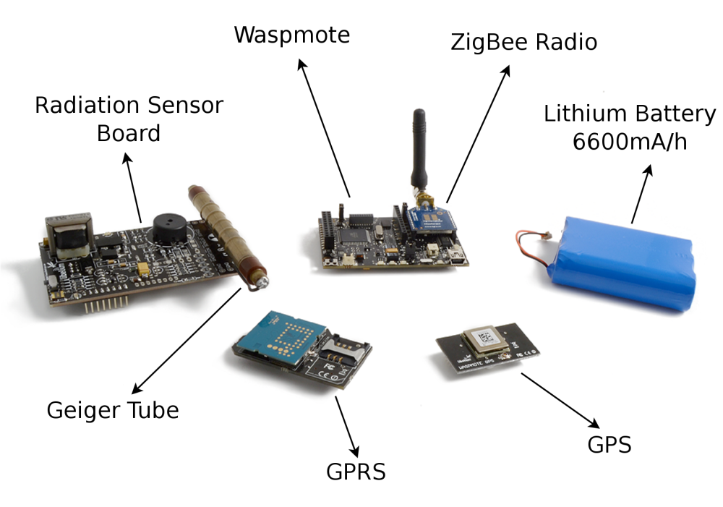

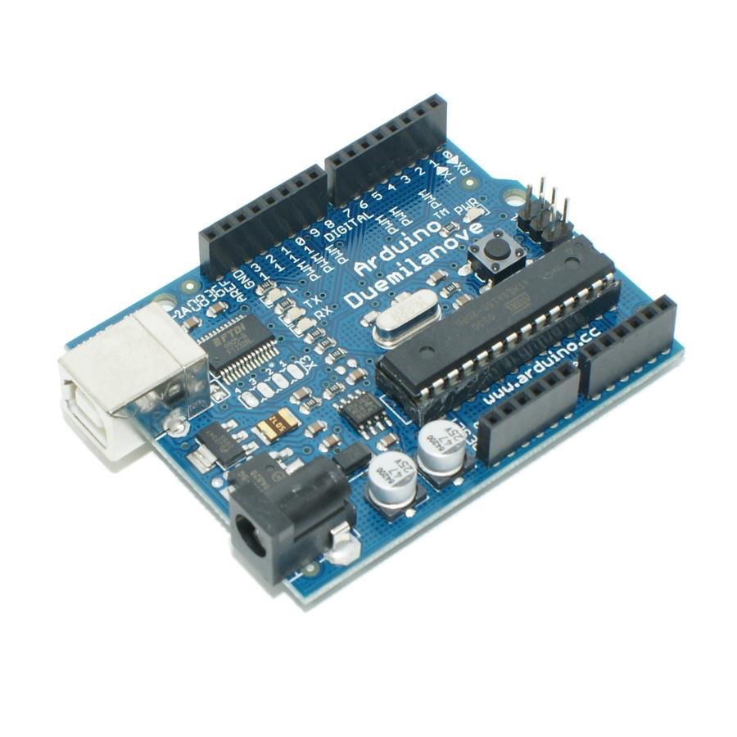
Product challenges
Many ERTS have complex life-cycle & require multi-disciplinary skills
Resource
constraint
Product
Memory
I/O
Processing
power
SCSJ 4423 – Real-time Software Engineering

Slide 6

Software engineer challenges
not many s/w engineers have the
multi-disciplinary skill required in ERTS
Complex team
members
Software
Engineer
Large team
members
team of s/w engineers is required
to complete the work in time
SCSJ 4423 – Real-time Software Engineering

Slide 7
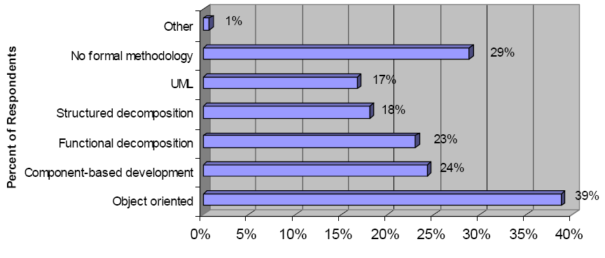
Software development challenges
Development
“One size fits all” technology no longer works
SCSJ 4423 – Real-time Software Engineering

Slide 8

Software Development for ERT
SCSJ 4423 – Real-time Software Engineering

Slide 9
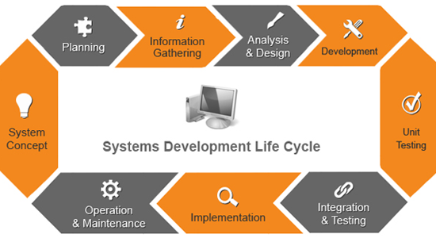
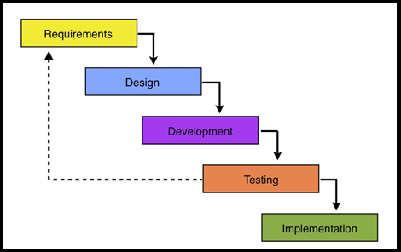
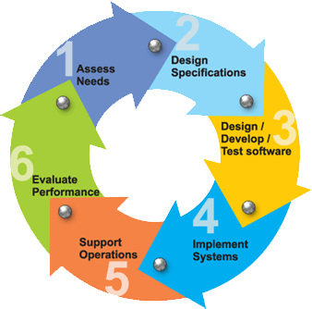
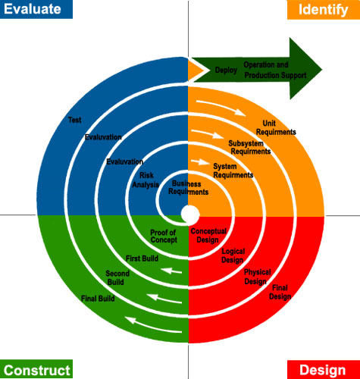
Software Development for ERT
SCSJ 4423 – Real-time Software Engineering

Slide 10
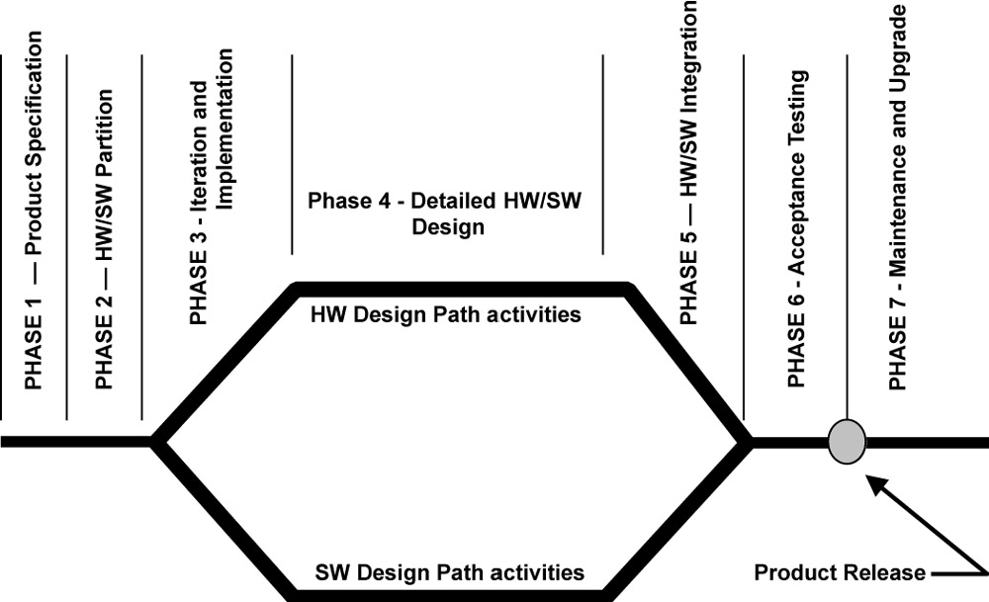
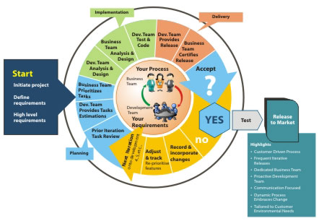
Software Development for ERT
Clear software development
Framework will ensure the
Successful of ERT system
Requirements
Architecture &
Design
Implementation
Verification &
Validation
SCSJ 4423 – Real-time Software Engineering

Slide 11
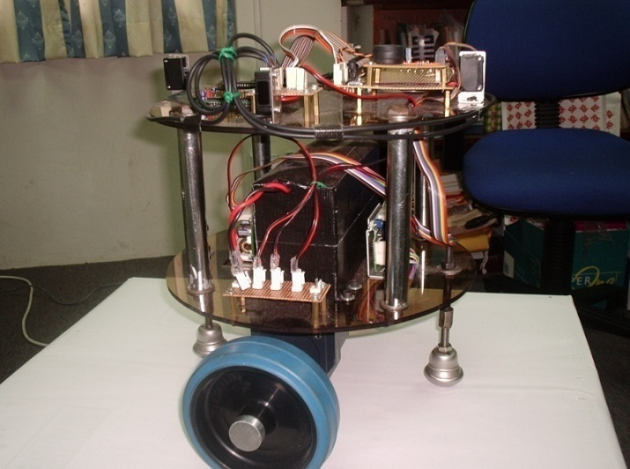
Software Development for ERT…example for requirements specification
Autonomous Mobile Robot Requirement
The AMR consists of a body and a pair of wheels. Each drive wheel is move by a direct-current (DC) motor. The speeds of the motors are sensed using shaft encoders and fed back to the embedded controller for computation of control signal to the DC motor every 100 milliseconds using the proportional-integral (PI) control algorithm. The embedded controller also monitors the robot environment using four infrared (IR) proximity sensors and communicates with human using Liquid Crystal Display (LCD) and switches.
Issues that must be addressed in the requirement specification phase for ERT system are :
  functional modeling,
  behavior modeling,
  timing,
  man-machine interface and
  hardware-software interface.
Requirements
SCSJ 4423 – Real-time Software Engineering

Slide 12
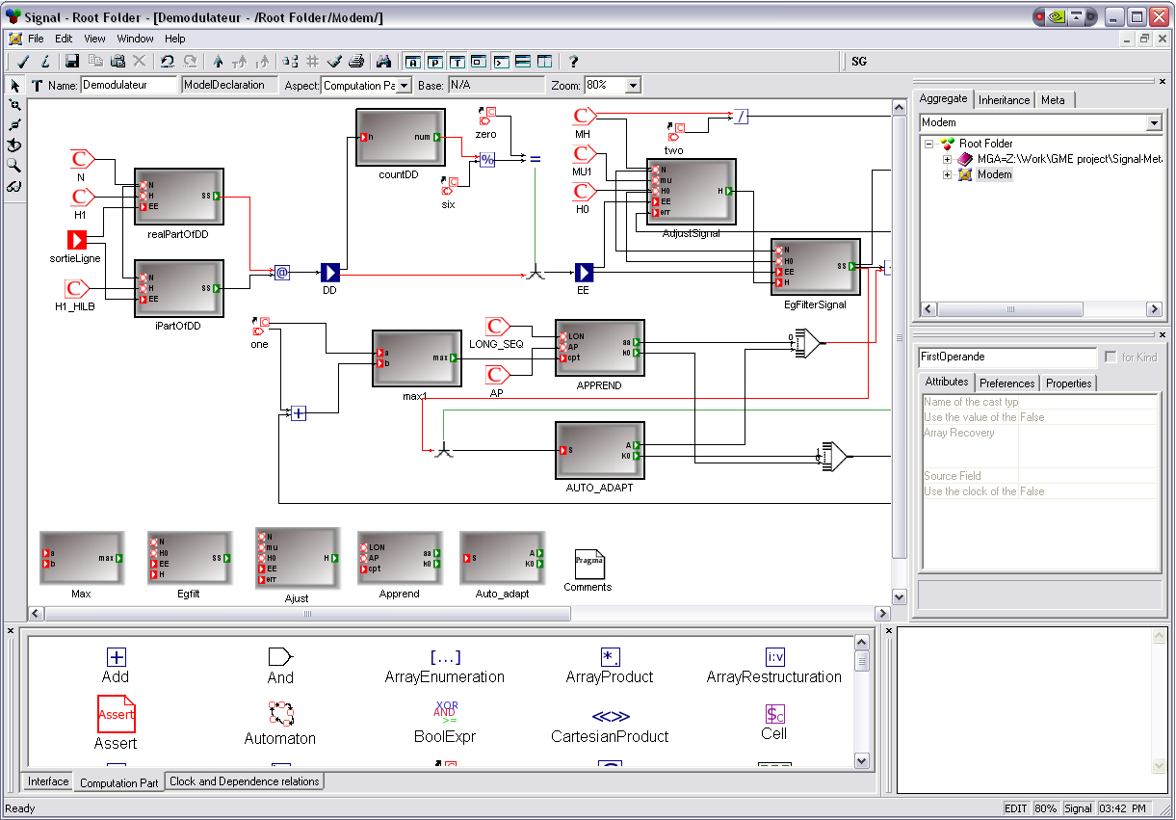
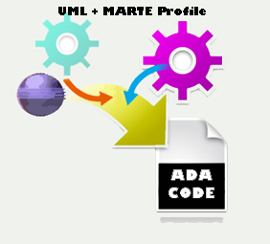
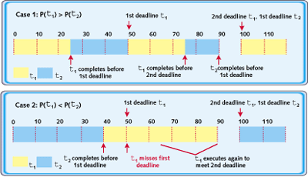

Software Development for ERT
Modeling
Object Oriented
Technology
Scheduling
Architecture &
Design
SCSJ 4423 – Real-time Software Engineering

Slide 13
Software Development for ERT
ERT can be implemented on a single or multi processor and multi tasks are designed to run on one single processor.
To implement multitasking or concurrency in ERTS, 2 software engineering principles need to be considered (Burn and Welling, 1996) are:
  real-time design methodology, which leads naturally into multitasking or concurrency implementation.
  how to undertake or support multitasking and concurrency in the implementation stage. There are 2 ways to support the factor either
    using concurrent real-time language (e.g. ADA) or
    use a sequential language together with a RTOS.
Implementation
SCSJ 4423 – Real-time Software Engineering

Slide 14

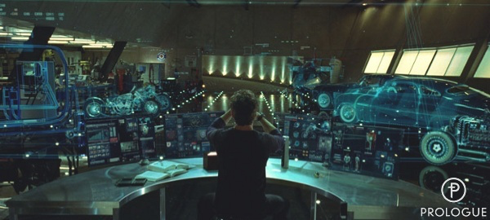
Software Development for ERT
Programmer
simulator
Main advantages of the proposed simulation strategy are:
  Testing can be done concurrently with the dev. of robot H/W.
  Communication through the H/W interface provides isolation between dev. of simulation.
  Code for H/W interface is similar and provide realistic timing to the actual robot H/W interface.
Verification &
Validation
SCSJ 4423 – Real-time Software Engineering

Slide 15
Interest of software engineer in ERT system
Well-trained
In software development
process
Well-trained
programmer
Rich knowledge
In programming
Related language
Adaptable
SCSJ 4423 – Real-time Software Engineering

Slide 16
Task of software engineer in ERT system development
To ensure the success of SE in addressing ERT systems problem, Stankovic, 1996, suggested SE will need to undergo a radical shift :
  Time, dependability, and other QoS constraints must become first-class concerns, coherently integrated with functionality at all levels from requirements specification through architecture, design, implementation, and execution.
  Evolvability must be ensured by separating platform-dependent concerns from application concerns .
  Software must be structured into compose-able modules in which interfaces capture not only functionality.
  Timing constraints, in particular on individual components, must be dynamically derived and imposed on the basis of end-to-end requirements.
SCSJ 4423 – Real-time Software Engineering

Slide 17

Thank You
SCSJ 4423 – Real-time Software Engineering

Slide 18

Problem solving
Start with your group
Refer e-Learning
SCSJ 4423 – Real-time Software Engineering

